Slide 1

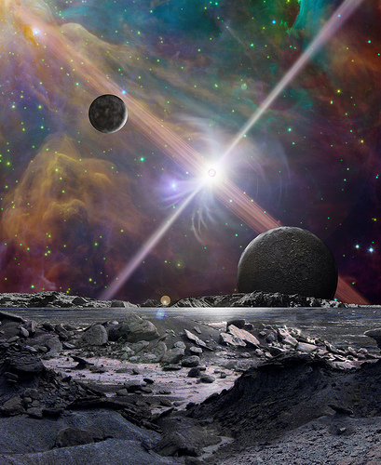
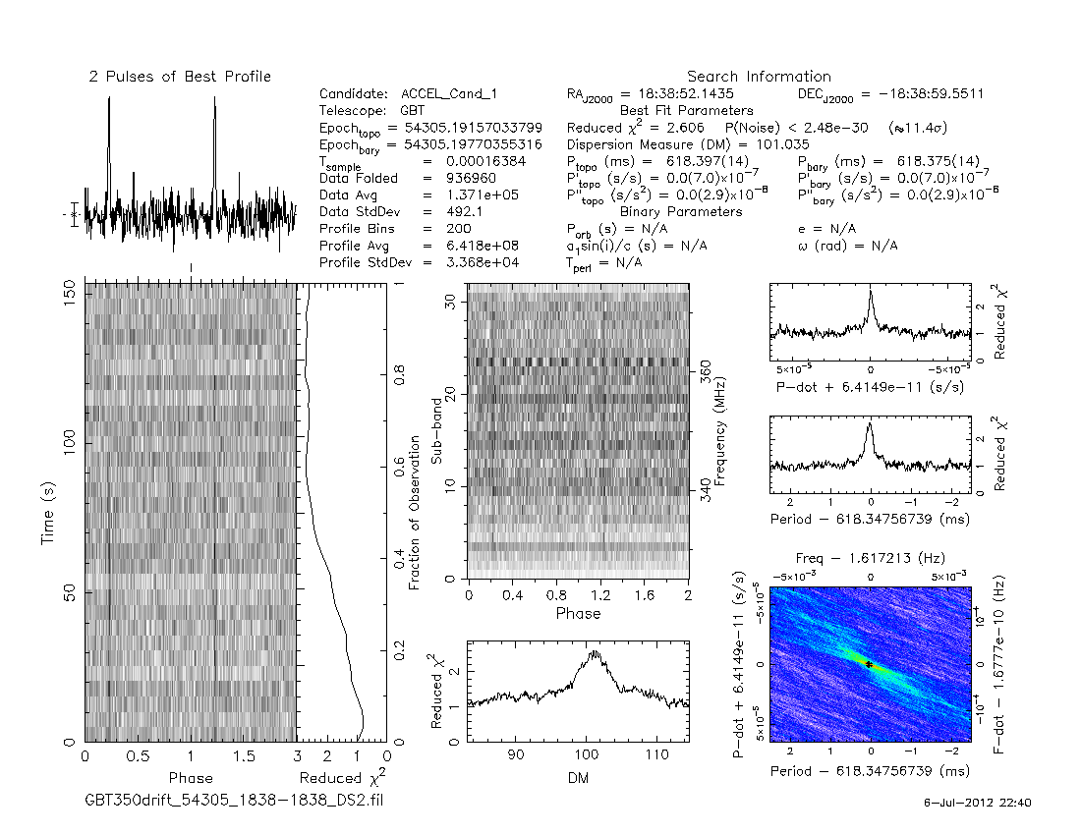
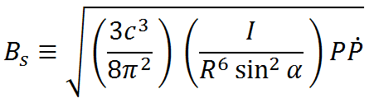
TITLE
Authors can go here
Schools
Abstract:
Televator Speech
Finally, an orbiting body must survive the extreme magnetic fields a pulsar constantly emits. Many pulsars have such powerful magnetic fields that it warps the electron clouds of atoms into needle-like shapes less than 1% of their original size, rendering much of the chemistry of life impossible in close proximity to the star. To calculate the magnetic field strength (measured in Gauss) of a pulsar, the radius of the pulsar (R), the angle between the pulsar’s magnetic poles and it’s rotational axis (α), and the pulsar’s moment of inertia (I) must be determined. Since, like before, these values are not easily accessible, a “typical” pulsar’s values are used, which are 10 km, 90⁰, and 10⁴⁵ g cm² respectively. These values, along with the pulsar’s period (P) and P-dot, which are how long in seconds it takes for one revolution and the rate of deceleration of the pulsar's angular velocity in revolutions per second per second, are then used to calculate the characteristic magnetic field using the following equation:
Discussion
Research Question
These results, although accurate, provide only a rough estimate of what these pulsars’ individual Roche Limits and magnetic fields actually are due to using generalized data.
Overall, this shows how hostile pulsar’s can be for both orbiting bodies and for life as we know it possibly existing on the planets. With the intense solar radiation emissions, strong gravitational pull, and powerful magnetic field of these pulsars, any Earth-like planets orbiting them would be little more than barren terrestrials, with very little chance of life as we know it existing on their surfaces. Despite these extreme conditions, there is a possibility that some form of life could exist in an ocean deep inside of a planet that is warmed by tidal friction, similar to Jupiter’s moon Europa, thereby providing heat for life and shielding the ocean from the pulsar’s intense radiation. Such a possibility is remote though, since so many different variables must be exactly right to achieve this.
There are several aspects of a pulsar that make the environment around it particularly dangerous for orbiting bodies. One of the more obvious dangers to anything orbiting a pulsar is the intense radiation that it emits, especially along the two iconic jets that pulsars produce. This radiation, being so powerful, would have the effect of blasting away any atmosphere the orbiting planets could have possibly formed.
Results
Pulsar | Table | Magnetic Field (Gauss)
J1738+0333 | 1.205 x 10⁶ km | 1.067 x 10¹⁴ G
J1719-1438 | 1.205 x 10⁶ km | 3.392 x 10¹⁴ G
J1801-1417 | 1.205 x 10⁶ km | 5.206 x 10¹³ G
Methods
References

