Slide 1



Getting Going in the Pulsar Search collaboratory (PSC)

Slide 2
Step 1 – Visit the Two Websites
The PSC uses two websites – make sure you can access them.
(WordPress Site - http://pulsarsearchcollaboratory.com) This site contains the training materials, supporting materials, and the Forum.
(Database Site - http://psrsearch.wvu.edu/) The site contains the data and is where you go to create an account.

Slide 3
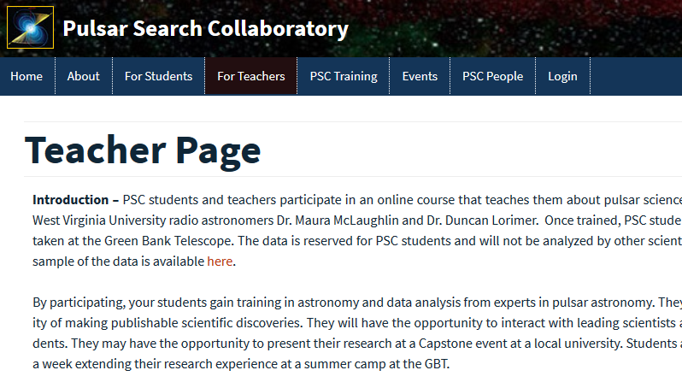
Step 2 – Let Us Know Who You Are
Visit the “Teacher Page” on the Database Site

Slide 4
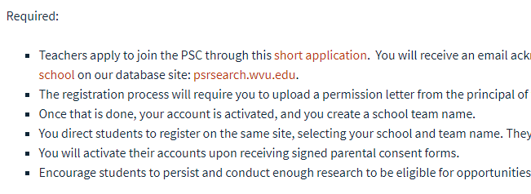
Step 2 – Select short Application
Scroll down the page to the “Required Section” and click on the “short application” link.

Slide 5
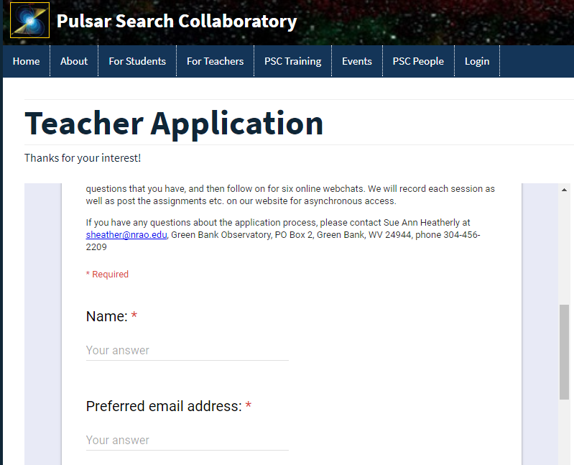
Step 2 – Fill out the form
This will get you on all the right mailing lists.
There is no need to wait for a response. You can proceed immediately to creating an account.

Slide 6
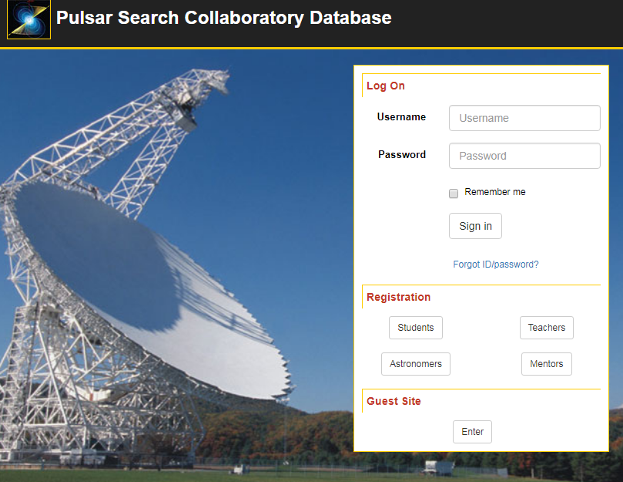
Step 3 – Create a Teacher Account
Go to the Database Site.
Select the Teachers Button in the Registration section (circled in red).

Slide 7
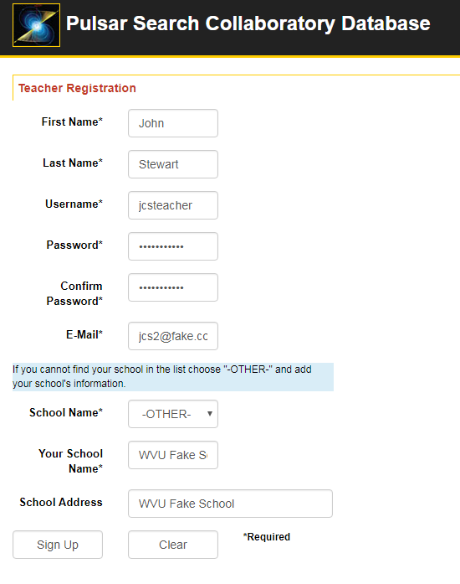
Step 3 – Create a Teacher Account
Fill out the form.
Select your school from the list (if you have done this before).
Select School Name –OTHER- if you are new. Enter your school name and address.
Push the Sign Up Button

Slide 8
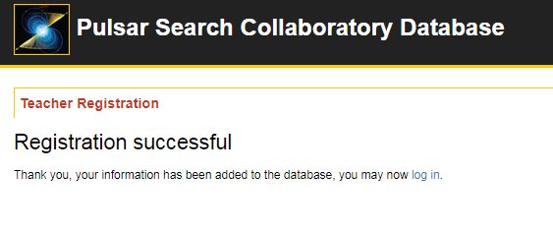
Step 3 – Account Created
You account has been created. You can log in by returning to the homepage of the Database Site by clicking the link circled above.

Slide 9
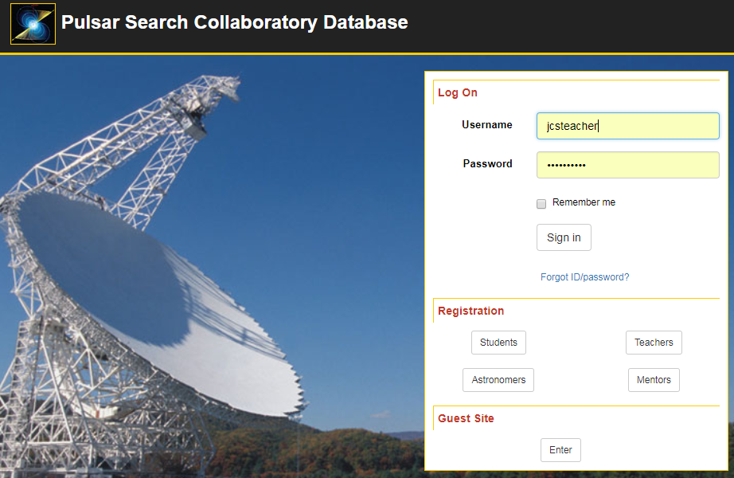
Step 4 – Login
Enter the user name and password you just created. Click “Sign In”

Slide 10
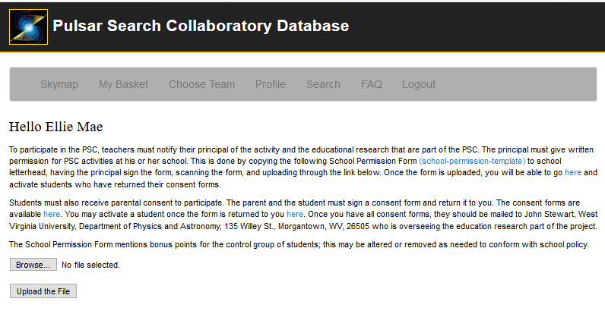
Step 4 – Login Success

Slide 11
Step 5 – School Permission
First, notify your principal that you would like to participate in the PSC.
If they agree, download the school-permission-template.docx file.
Transfer it to school letterhead.
Have the principal sign it.
Scan the document.
Upload to the Database Site.
Your account is fully activated and you can activate students.

Slide 12
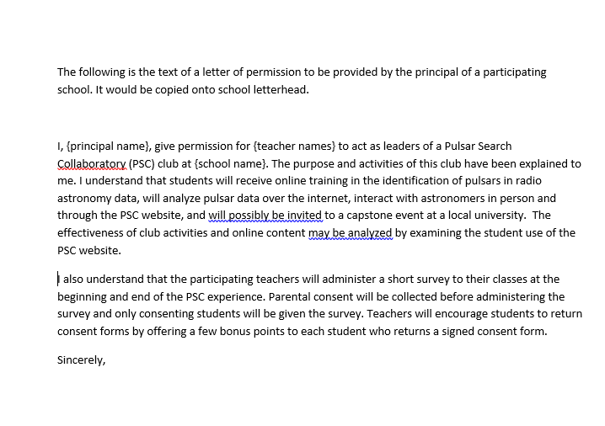
Step 5 – School Permission Template
The link will download a Word file that looks like this.

Slide 13
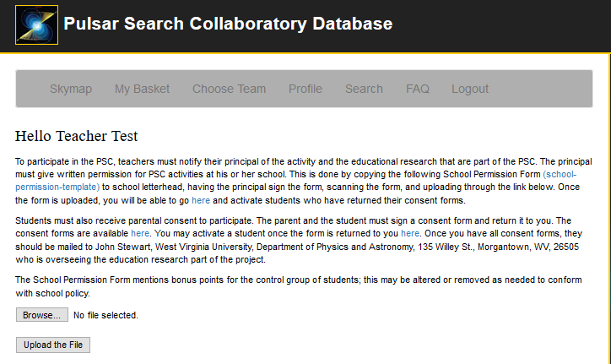
Step 5 – Upload the Letter
Log back into your account at the database site ( http://psrsearch.wvu.edu/ )
Upload your permission letter by Browsing (Choose File) to the letter and clicking Upload the File.

Slide 14
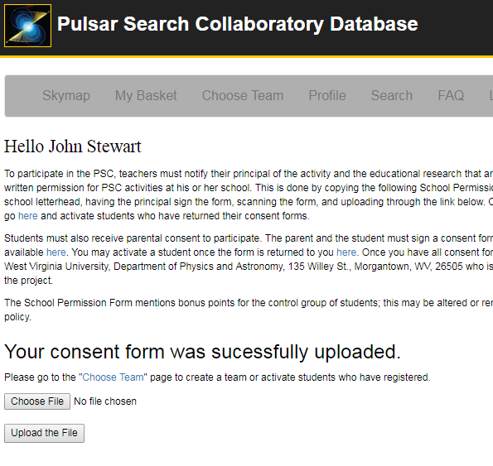
Step 6 – Create a School Team
Students join by selecting a team. Your next step is to create one or more teams for your school.
Normally teachers create one team and name it after their school.
Select the Choose Team tab to get started.

Slide 15
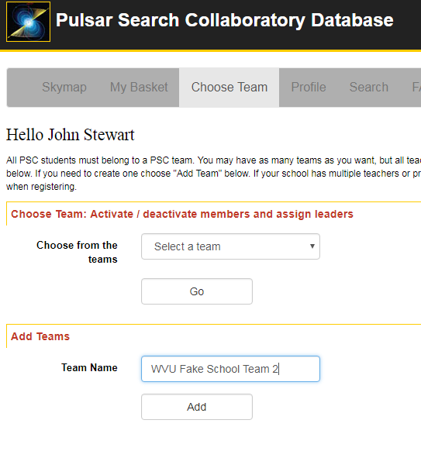
Step 6 – Create a School Team
All students must belong to a PSC team. Create your team by entering a Team Name and clicking Add in the Add Teams part of the Choose Teams page.

Slide 16
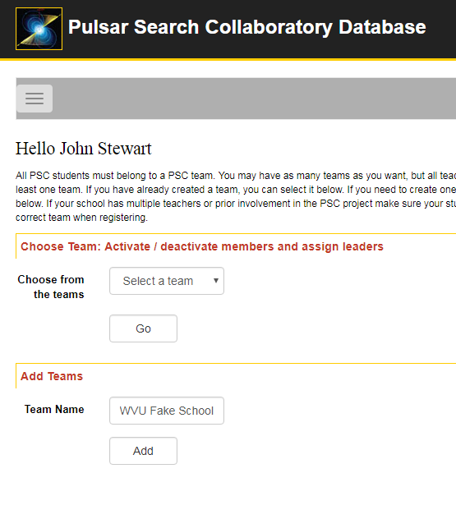
Step 6 – Hidden Menu
Depending on the screen width, the menu with Choose Team may be hidden. Click on the menu icon in the red circle to show it.

Slide 17
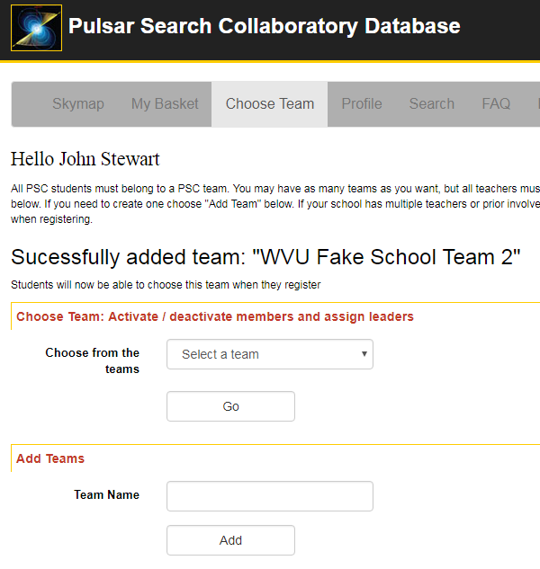
Step 6 – Success
You team has been created.

Slide 18
Step 6 – View your Team
To view your team, select your team from Choose from the teams and push Go.

Slide 19
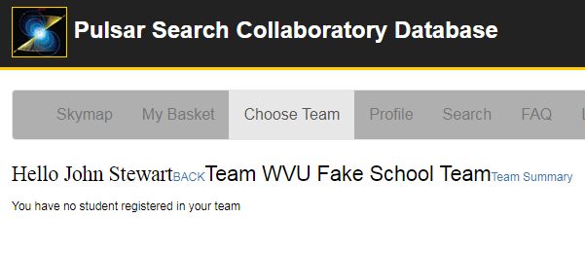
Step 6 – No Students Yet
Your team is brand new, so no students have selected it yet.
Students can now create their accounts.

Slide 20
Step 7 – Create a Student Account
Creating a student account is just like creating a teacher account.
Go to the Database Site ( http://psrsearch.wvu.edu/ )
Click Register

Slide 21
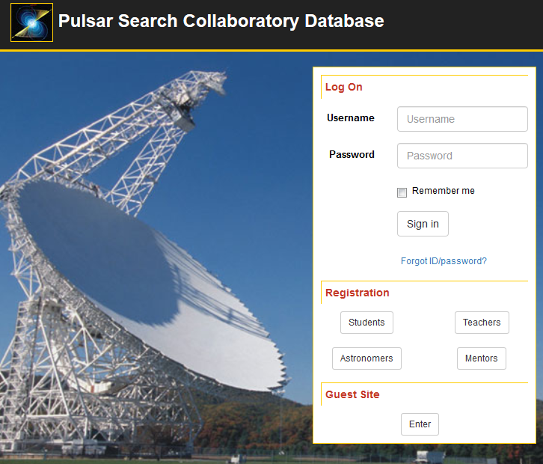
Step 7 – Have student go to the Database site
Your student should click Students in the Registration Section.

Slide 22
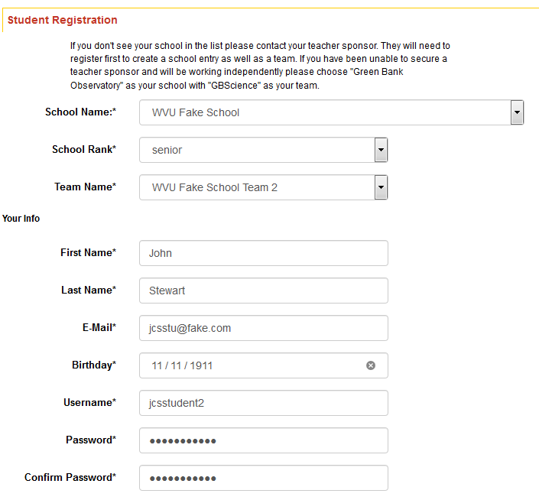
Step 7 – Fill out the form
Your student should select the school you entered and the school team. Click Sign Up at the bottom of the form.

Slide 23
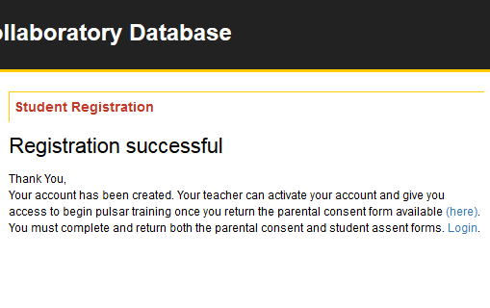
Step 7 –Success
The student has created an account but it is not active. You can activate the account once the student returns his or her consent form.

Slide 24
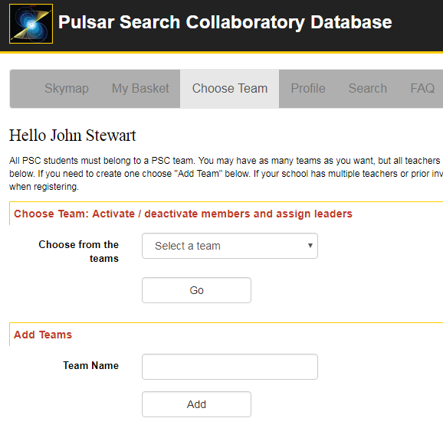
Step 8 – Active Your student’s account
Log into the Database site and select the Choose Team tab.
Select your school team from Choose from the teams and push Go.

Slide 25
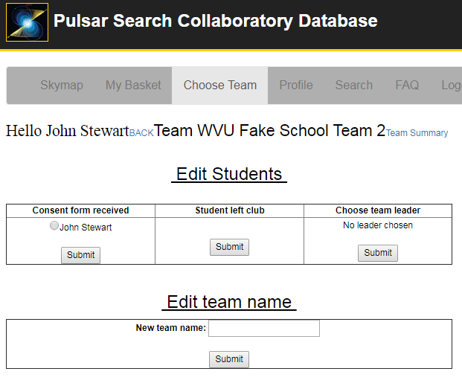


Step 8 – Active Your student’s account
Once the student returns the consent form, activate them on this page.
Select the student and push Submit.
Inactive Students
Active Students

Slide 26
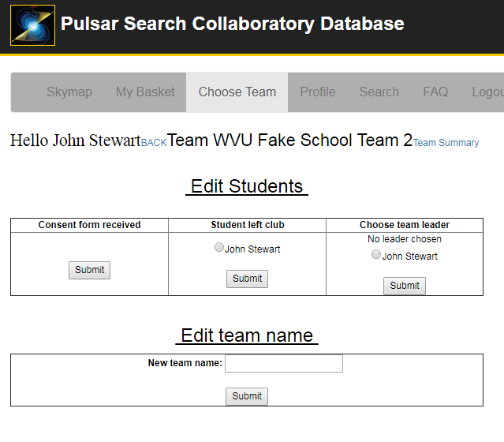
Step 8 – Success
The student is moved for the consent received column to the Student left club column.
Your student’s account is active and they have access to the Database Site and can begin training.

Slide 27
Questions?
You and your students will receive additional training on using the Database Site and the certification tests as you go through the six training modules.
Contact Sue Ann Heatherly at sheather@nrao.edu, if you have any questions.

